Slide 1

14
Material Requirements Planning (MRP) and ERP
PowerPoint presentation to accompany
Heizer and Render
Operations Management, 10e
Principles of Operations Management, 8e
PowerPoint slides by Jeff Heyl

Slide 2
Outline
Global Company Profile: Wheeled Coach
Dependent Demand
Dependent Inventory Model Requirements
  Master Production Schedule
  Bills of Material
  Accurate Inventory Records
  Purchase Orders Outstanding
  Lead Times for Components

Slide 3
Outline – Continued
MRP Structure
MRP Management
  MRP Dynamics
  MRP and JIT
Lot-Sizing Techniques

Slide 4
Outline – Continued
Extensions of MRP
  Material Requirements Planning II (MRP II)
  Closed-Loop MRP
  Capacity Planning
MRP In Services
  Distribution Resource Planning (DRP)

Slide 5
Outline – Continued
Enterprise Resource Planning (ERP)
  Advantages and Disadvantages of ERP Systems
  ERP in the Service Sector

Slide 6
Learning Objectives
When you complete this chapter you should be able to:
Develop a product structure
Build a gross requirements plan
Build a net requirements plan
Determine lot sizes for lot-for-lot, EOQ, and PPB

Slide 7
Learning Objectives
When you complete this chapter you should be able to:
Describe MRP II
Describe closed-loop MRP
Describe ERP

Slide 8
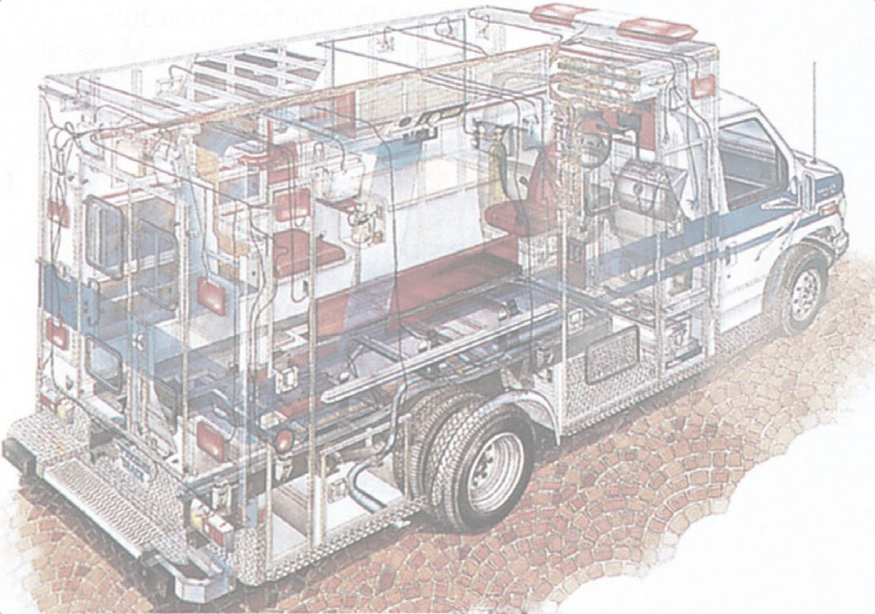
Wheeled Coach
Largest manufacturer of ambulances in the world
International competitor
12 major ambulance designs
  18,000 different inventory items
  6,000 manufactured parts
  12,000 purchased parts

Slide 9
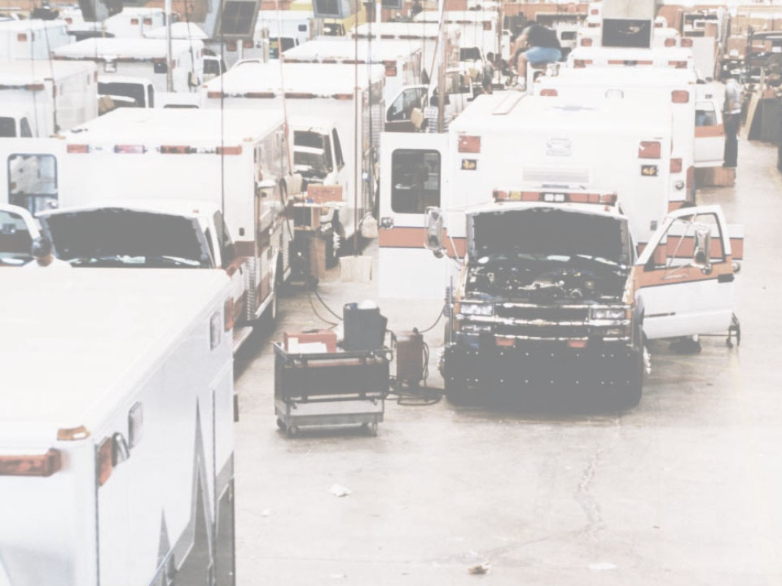
Wheeled Coach
Four Key Tasks
  Material plan must meet both the requirements of the master schedule and the capabilities of the production facility
  Plan must be executed as designed
  Minimize inventory investment
  Maintain excellent record integrity

Slide 10
Dependent Demand
For any product for which a schedule can be established, dependent demand techniques should be used

Slide 11
Dependent Demand
Benefits of MRP
Better response to customer orders
Faster response to market changes
Improved utilization of facilities and labor
Reduced inventory levels

Slide 12
Dependent Demand
The demand for one item is related to the demand for another item
Given a quantity for the end item, the demand for all parts and components can be calculated
In general, used whenever a schedule can be established for an item
MRP is the common technique

Slide 13
Dependent Demand
Effective use of dependent demand inventory models requires the following
  Master production schedule
  Specifications or bill of material
  Inventory availability
  Purchase orders outstanding
  Lead times

Slide 14
Master Production Schedule (MPS)
Specifies what is to be made and when
Must be in accordance with the aggregate production plan
Inputs from financial plans, customer demand, engineering, supplier performance
As the process moves from planning to execution, each step must be tested for feasibility
The MPS is the result of the production planning process

Slide 15
Master Production Schedule (MPS)
MPS is established in terms of specific products
Schedule must be followed for a reasonable length of time
The MPS is quite often fixed or frozen in the near term part of the plan
The MPS is a rolling schedule
The MPS is a statement of what is to be produced, not a forecast of demand

Slide 16
The Planning Process
Production
Capacity
Inventory
Marketing
Customer
demand
Finance
Cash flow
Procurement
Supplier
performance
Human resources
Manpower
planning
Management
Return on
investment
Capital
Aggregate production plan
Engineering
Design
completion
Change production plan?
Master production schedule
Figure 14.1

Slide 17
The Planning Process
Master production schedule
Change master production schedule?
Change requirements?
Material requirements plan
Change capacity?
Capacity requirements plan
No
Is capacity plan being met?
Is execution meeting the plan?
Realistic?
Yes
Execute capacity plans
Execute
material plans
Figure 14.1

Slide 18
Aggregate
Production Plan
Months January February
Aggregate Production Plan 1,500 1,200
(Shows the total
quantity of amplifiers)
Weeks 1 2 3 4 5 6 7 8
Master Production Schedule
(Shows the specific type and
quantity of amplifier to be
produced
240-watt amplifier 100 100 100 100
150-watt amplifier 500 500 450 450
75-watt amplifier 300 100
Figure 14.2

Slide 19
Master Production Schedule (MPS)
Can be expressed in any of the following terms:
A customer order in a job shop (make-to-order) company
Modules in a repetitive (assemble-to-order or forecast) company
An end item in a continuous (stock-to-forecast) company

Slide 20
Focus for Different
Process Strategies
Make to Order
(Process Focus)
Assemble to Order or Forecast
(Repetitive)
Stock to Forecast
(Product Focus)
Number of inputs
Schedule orders
Typical focus of the master production schedule
Schedule modules
Number of end items
Schedule finished product
Examples: Print shop Motorcycles Steel, Beer, Bread
Machine shop Autos, TVs Lightbulbs
Fine-dining restaurant Fast-food restaurant Paper
Figure 14.3

Slide 21
MPS Examples
For Nancy’s Specialty Foods
Gross Requirements for Crabmeat Quiche
Day 6 7 8 9 10 11 12 13 14 and so on
Amount 50 100 47 60 110 75
Gross Requirements for Spinach Quiche
Day 7 8 9 10 11 12 13 14 15 16 and so on
Amount 100 200 150 60 75 100
Table 14.1

Slide 22
Bills of Material
List of components, ingredients, and materials needed to make product
Provides product structure
  Items above given level are called parents
  Items below given level are called children

Slide 23



BOM Example
Level
Product structure for “Awesome” (A)
0
A
1
B₍₂₎ Std. 12” Speaker kit
C₍₃₎
Std. 12” Speaker kit w/ amp-booster
2
E₍₂₎
E₍₂₎
F₍₂₎
Std. 12” Speaker booster assembly
Packing box and installation kit of wire, bolts, and screws
3
D₍₂₎
G₍₁₎
D₍₂₎
Amp-booster
12” Speaker
12” Speaker

Slide 24
BOM Example
Level
Product structure for “Awesome” (A)
0
A
Part B: 2 x number of As = (2)(50) = 100
Part C: 3 x number of As = (3)(50) = 150
Part D: 2 x number of Bs
+ 2 x number of Fs = (2)(100) + (2)(300) = 800
Part E: 2 x number of Bs
+ 2 x number of Cs = (2)(100) + (2)(150) = 500
Part F: 2 x number of Cs = (2)(150) = 300
Part G: 1 x number of Fs = (1)(300) = 300
1
B₍₂₎ Std. 12” Speaker kit
C₍₃₎
Std. 12” Speaker kit w/ amp-booster
2
E₍₂₎
E₍₂₎
F₍₂₎
Std. 12” Speaker booster assembly
Packing box and installation kit of wire, bolts, and screws
3
D₍₂₎
G₍₁₎
D₍₂₎
Amp-booster
12” Speaker
12” Speaker

Slide 25
Bills of Material
Modular Bills
  Modules are not final products but components that can be assembled into multiple end items
  Can significantly simplify planning and scheduling

Slide 26
Bills of Material
Planning Bills
  Also called “pseudo” or super bills
  Created to assign an artificial parent to the BOM
  Used to group subassemblies to reduce the number of items planned and scheduled
  Used to create standard “kits” for production

Slide 27
Bills of Material
Phantom Bills
  Describe subassemblies that exist only temporarily
  Are part of another assembly and never go into inventory
Low-Level Coding
  Item is coded at the lowest level at which it occurs
  BOMs are processed one level at a time

Slide 28
Accurate Records
Accurate inventory records are absolutely required for MRP (or any dependent demand system) to operate correctly
Generally MRP systems require more than 99% accuracy
Outstanding purchase orders must accurately reflect quantities and scheduled receipts

Slide 29
Lead Times
The time required to purchase, produce, or assemble an item
  For production – the sum of the order, wait, move, setup, store, and run times
  For purchased items – the time between the recognition of a need and the availability of the item for production

Slide 30
Time-Phased Product Structure
Start production of D
Must have D and E completed here so production can begin on B
1 week
2 weeks to produce
D
B
2 weeks
E
A
2 weeks
1 week
E
2 weeks
1 week
G
C
3 weeks
F
1 week
D
| | | | | | | |
1 2 3 4 5 6 7 8
Figure 14.4
Time in weeks

Slide 31
MRP Structure
Data Files
Output Reports
BOM
MRP by period report
Master
production schedule
MRP by date report
Lead times
(Item master file)
Planned order report
Inventory data
Material requirement planning programs (computer and software)
Purchase advice
Purchasing data
Exception reports
Order early or late or not needed
Order quantity too small or too large
Figure 14.5

Slide 32
Determining Gross Requirements
Starts with a production schedule for the end item – 50 units of Item A in week 8
Using the lead time for the item, determine the week in which the order should be released – a 1 week lead time means the order for 50 units should be released in week 7
This step is often called “lead time offset” or “time phasing”

Slide 33
Determining Gross Requirements
From the BOM, every Item A requires 2 Item Bs – 100 Item Bs are required in week 7 to satisfy the order release for Item A
The lead time for the Item B is 2 weeks – release an order for 100 units of Item B in week 5
The timing and quantity for component requirements are determined by the order release of the parent(s)

Slide 34
Determining Gross Requirements
The process continues through the entire BOM one level at a time – often called “explosion”
By processing the BOM by level, items with multiple parents are only processed once, saving time and resources and reducing confusion
Low-level coding ensures that each item appears at only one level in the BOM

Slide 35
Gross Requirements Plan
Week
1 2 3 4 5 6 7 8 Lead Time
Required date 50
Order release date 50 1 week
Required date 100
Order release date 100 2 weeks
Required date 150
Order release date 150 1 week
Required date 200 300
Order release date 200 300 2 weeks
Required date 300
Order release date 300 3 weeks
Required date 600 200
Order release date 600 200 1 week
Required date 300
Order release date 300 2 weeks
Table 14.3

Slide 36
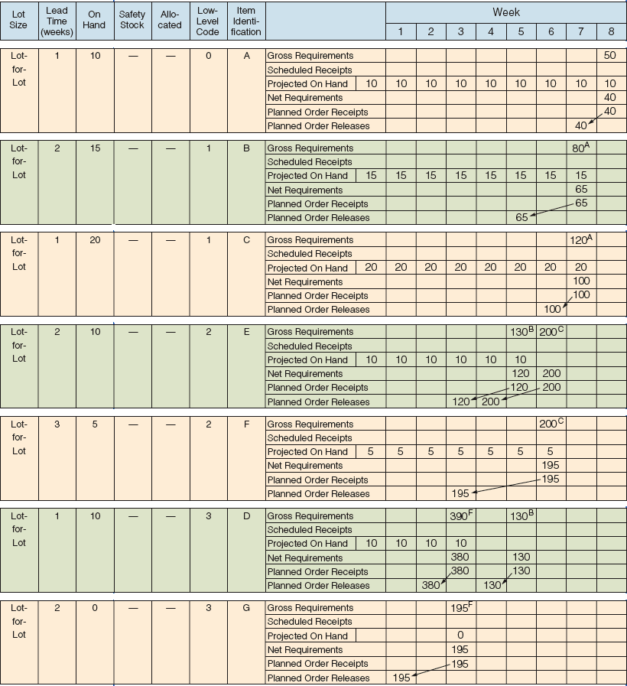
Net Requirements Plan

Slide 37
Net Requirements Plan

Slide 38
Determining Net Requirements
Starts with a production schedule for the end item – 50 units of Item A in week 8
Because there are 10 Item As on hand, only 40 are actually required – (net requirement) = (gross requirement - on- hand inventory)
The planned order receipt for Item A in week 8 is 40 units – 40 = 50 - 10

Slide 39
Determining Net Requirements
Following the lead time offset procedure, the planned order release for Item A is now 40 units in week 7
The gross requirement for Item B is now 80 units in week 7
There are 15 units of Item B on hand, so the net requirement is 65 units in week 7
A planned order receipt of 65 units in week 7 generates a planned order release of 65 units in week 5

Slide 40
Determining Net Requirements
A planned order receipt of 65 units in week 7 generates a planned order release of 65 units in week 5
The on-hand inventory record for Item B is updated to reflect the use of the 15 items in inventory and shows no on-hand inventory in week 8
This is referred to as the Gross-to-Net calculation and is the third basic function of the MRP process

Slide 41
Gross Requirements Schedule
Figure 14.6
A
S
B
C
B
C
Master schedule
for B
sold directly
Lead time = 4 for A
Master schedule for A
Lead time = 6 for S
Master schedule for S
Periods
5
6
7
8
9
10
11
8
9
10
11
12
13
1
2
3
40
50
15
40
20
30
10
10
Periods
1
2
3
4
5
6
7
8
40+10
15+30
Therefore, these are the gross requirements for B
Gross requirements: B
10
=50
40
50
20
=45

Slide 42
Net Requirements Plan
The logic of net requirements
Gross requirements
+
Allocations
Total requirements
–
On hand
+
Scheduled receipts
=
Net requirements
Available inventory

Slide 43
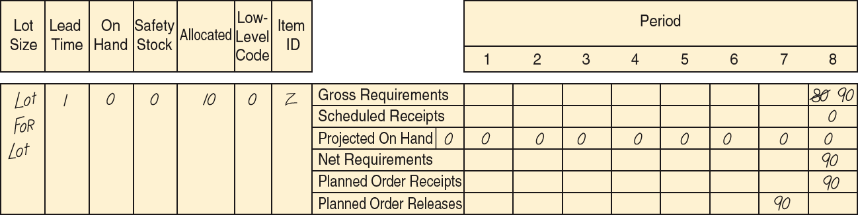
MRP Planning Sheet
Figure 14.7

Slide 44
Safety Stock
BOMs, inventory records, purchase and production quantities may not be perfect
Consideration of safety stock may be prudent
Should be minimized and ultimately eliminated
Typically built into projected on-hand inventory

Slide 45
MRP Management
MRP is a dynamic system
Facilitates replanning when changes occur
  Regenerating
  Net change
System nervousness can result from too many changes
Time fences put limits on replanning
Pegging links each item to its parent allowing effective analysis of changes

Slide 46
MRP and JIT
MRP is a planning system that does not do detailed scheduling
MRP requires fixed lead times which might actually vary with batch size
JIT excels at rapidly moving small batches of material through the system

Slide 47
Finite Capacity Scheduling
MRP systems do not consider capacity during normal planning cycles
Finite capacity scheduling (FCS) recognizes actual capacity limits
By merging MRP and FCS, a finite schedule is created with feasible capacities which facilitates rapid material movement

Slide 48
Small Bucket Approach
MRP “buckets” are reduced to daily or hourly
Planned receipts are used internally to sequence production
Inventory is moved through the plant on a JIT basis
Completed products are moved to finished goods inventory which reduces required quantities for subsequent planned orders
Back flushing based on the BOM is used to deduct inventory that was used in production

Slide 49

Balanced Flow
Used in repetitive operations
MRP plans are
executed using
JIT techniques
based on “pull”
principles
Flows are carefully
balanced with
small lot sizes

Slide 50
Supermarket
Items used by many products are held in a common area often called a supermarket
Items are withdrawn as needed
Inventory is maintained using JIT systems and procedures
Common items are not planned by the MRP system

Slide 51
Lot-Sizing Techniques
Lot-for-lot techniques order just what is required for production based on net requirements
  May not always be feasible
  If setup costs are high, lot-for-lot can be expensive
Economic order quantity (EOQ)
  EOQ expects a known constant demand and MRP systems often deal with unknown and variable demand

Slide 52
Lot-Sizing Techniques
Part Period Balancing (PPB) looks at future orders to determine most economic lot size
The Wagner-Whitin algorithm is a complex dynamic programming technique
  Assumes a finite time horizon
  Effective, but computationally burdensome

Slide 53
Lot-for-Lot Example
 |  | 1 | 2 | 3 | 4 | 5 | 6 | 7 | 8 | 9 | 10
Gross requirements |  | 35 | 30 | 40 | 0 | 10 | 40 | 30 | 0 | 30 | 55
Scheduled receipts
Projected on hand | 35 | 35 | 0 | 0 | 0 | 0 | 0 | 0 | 0 | 0 | 0
Net requirements |  | 0 | 30 | 40 | 0 | 10 | 40 | 30 | 0 | 30 | 55
Planned order receipts |  |  | 30 | 40 |  | 10 | 40 | 30 |  | 30 | 55
Planned order releases |  | 30 | 40 |  | 10 | 40 | 30 |  | 30 | 55
Holding cost = $1/week; Setup cost = $100; Lead time = 1 week

Slide 54
Lot-for-Lot Example
No on-hand inventory is carried through the system
Total holding cost = $0
There are seven setups for this item in this plan
Total ordering cost = 7 x $100 = $700
 |  | 1 | 2 | 3 | 4 | 5 | 6 | 7 | 8 | 9 | 10
Gross requirements |  | 35 | 30 | 40 | 0 | 10 | 40 | 30 | 0 | 30 | 55
Scheduled receipts
Projected on hand | 35 | 35 | 0 | 0 | 0 | 0 | 0 | 0 | 0 | 0 | 0
Net requirements |  | 0 | 30 | 40 | 0 | 10 | 40 | 30 | 0 | 30 | 55
Planned order receipts |  |  | 30 | 40 |  | 10 | 40 | 30 |  | 30 | 55
Planned order releases |  | 30 | 40 |  | 10 | 40 | 30 |  | 30 | 55
Holding cost = $1/week; Setup cost = $100; Lead time = 1 week

Slide 55
EOQ Lot Size Example
 |  | 1 | 2 | 3 | 4 | 5 | 6 | 7 | 8 | 9 | 10
Gross requirements |  | 35 | 30 | 40 | 0 | 10 | 40 | 30 | 0 | 30 | 55
Scheduled receipts
Projected on hand | 35 | 35 | 0 | 43 | 3 | 3 | 66 | 26 | 69 | 69 | 39
Net requirements |  | 0 | 30 | 0 | 0 | 7 | 0 | 4 | 0 | 0 | 16
Planned order receipts |  |  | 73 |  |  | 73 |  | 73 |  |  | 73
Planned order releases |  | 73 |  |  | 73 |  | 73 |  |  | 73
Holding cost = $1/week; Setup cost = $100; Lead time = 1 week
Average weekly gross requirements = 27; EOQ = 73 units

Slide 56
EOQ Lot Size Example
Annual demand = 1,404
Total cost = setup cost + holding cost
Total cost = (1,404/73) x $100 + (73/2) x ($1 x 52 weeks)
Total cost = $3,798
Cost for 10 weeks = $3,798 x (10 weeks/52 weeks) = $730
 |  | 1 | 2 | 3 | 4 | 5 | 6 | 7 | 8 | 9 | 10
Gross requirements |  | 35 | 30 | 40 | 0 | 10 | 40 | 30 | 0 | 30 | 55
Scheduled receipts
Projected on hand | 35 | 35 | 0 | 0 | 0 | 0 | 0 | 0 | 0 | 0 | 0
Net requirements |  | 0 | 30 | 0 | 0 | 7 | 0 | 4 | 0 | 0 | 16
Planned order receipts |  |  | 73 |  |  | 73 |  | 73 |  |  | 73
Planned order releases |  | 73 |  |  | 73 |  | 73 |  |  | 73
Holding cost = $1/week; Setup cost = $100; Lead time = 1 week
Average weekly gross requirements = 27; EOQ = 73 units

Slide 57
PPB Example
 |  | 1 | 2 | 3 | 4 | 5 | 6 | 7 | 8 | 9 | 10
Gross requirements |  | 35 | 30 | 40 | 0 | 10 | 40 | 30 | 0 | 30 | 55
Scheduled receipts
Projected on hand | 35
Net requirements
Planned order receipts
Planned order releases
Holding cost = $1/week; Setup cost = $100; Lead time = 1 week
EPP = 100 units

Slide 58
PPB Example
Trial Lot Size
Periods (cumulative net Costs
Combined requirements) Part Periods Setup Holding Total
2 30 0
2, 3 70 40 = 40 x 1
2, 3, 4 70 40
2, 3, 4, 5 80 70 = 40 x 1 + 10 x 3 100 70 170
2, 3, 4, 5, 6 120 230 = 40 x 1 + 10 x 3
+ 40 x 4
 |  | 1 | 2 | 3 | 4 | 5 | 6 | 7 | 8 | 9 | 10
Gross requirements |  | 35 | 30 | 40 | 0 | 10 | 40 | 30 | 0 | 30 | 55
Scheduled receipts
Projected on hand | 35
Net requirements
Planned order receipts
Planned order releases
+
=
Combine periods 2 - 5 as this results in the Part Period closest to the EPP
6 40 0
6, 7 70 30 = 30 x 1
6, 7, 8 70 30 = 30 x 1 + 0 x 2
6, 7, 8, 9 100 120 = 30 x 1 + 30 x 3 100 120 220
+
=
Combine periods 6 - 9 as this results in the Part Period closest to the EPP
+
=
10 55 0 100 0 100
Total cost 300 190 490
Holding cost = $1/week; Setup cost = $100;
EPP = 100 units
+
=

Slide 59
PPB Example
 |  | 1 | 2 | 3 | 4 | 5 | 6 | 7 | 8 | 9 | 10
Gross requirements |  | 35 | 30 | 40 | 0 | 10 | 40 | 30 | 0 | 30 | 55
Scheduled receipts
Projected on hand | 35 | 35 | 0 | 50 | 10 | 10 | 0 | 60 | 30 | 30 | 0
Net requirements |  | 0 | 30 | 0 | 0 | 0 | 40 | 0 | 0 | 0 | 55
Planned order receipts |  |  | 80 |  |  |  | 100 |  |  |  | 55
Planned order releases |  | 80 |  |  |  | 100 |  |  |  | 55
Holding cost = $1/week; Setup cost = $100; Lead time = 1 week
EPP = 100 units

Slide 60
Lot-Sizing Summary
For these three examples
Lot-for-lot $700
EOQ $730
PPB $490
Wagner-Whitin would have yielded a plan with a total cost of $455

Slide 61

Lot-Sizing Summary
In theory, lot sizes should be recomputed whenever there is a lot size or order quantity change
In practice, this results in system nervousness and instability
Lot-for-lot should
be used when
low-cost JIT can
be achieved

Slide 62
Lot-Sizing Summary
Lot sizes can be modified to allow for scrap, process constraints, and purchase lots
Use lot-sizing with care as it can cause considerable distortion of requirements at lower levels of the BOM
When setup costs are significant and demand is reasonably smooth, PPB, Wagner-Whitin, or EOQ should give reasonable results

Slide 63
Extensions of MRP
MRP II
Closed-Loop MRP
  MRP system provides input to the capacity plan, MPS, and production planning process
Capacity Planning
  MRP system generates a load report which details capacity requirements
  This is used to drive the capacity planning process
  Changes pass back through the MRP system for rescheduling

Slide 64
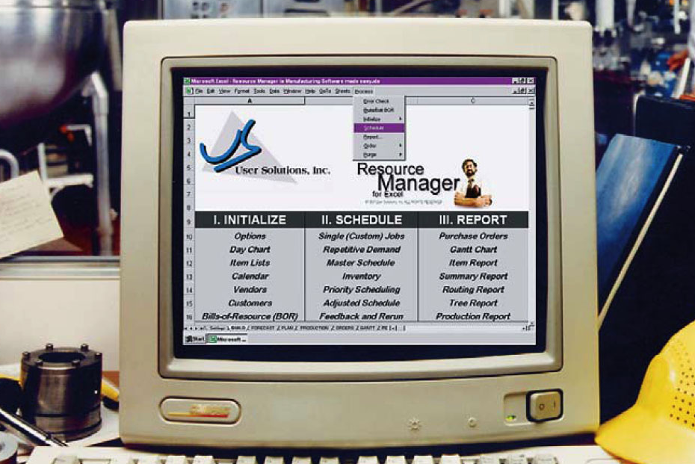
Material Requirements Planning II
Requirement data can be enriched by other resources
Generally called MRP II or Material Resource Planning
Outputs include
  Scrap
  Packaging waste
  Carbon emissions
Data used by purchasing, production scheduling, capacity planning, inventory

Slide 65
Material Resource Planning
 |  | Weeks
 | LT | 5 | 6 | 7 | 8
Computer | 1 |  |  |  | 100
Labor Hrs: .2 each |  |  |  |  | 20
Machine Hrs: .2 each |  |  |  |  | 20
Scrap: 1 ounce fiberglass each |  |  |  |  | 6.25 | lbs
Payables: $0 each |  |  |  |  | $0
PC Board (1 each) | 2 |  |  | 100
Labor Hrs: .15 each |  |  |  | 15
Machine Hrs: .1 each |  |  |  | 10
Scrap: .5 ounces copper each |  |  |  | 3.125 | lb
Payables: raw material at $5 each |  |  |  | $500
Processor (5 each) | 4 | 500
Labor Hrs: .2 each |  | 100
Machine Hrs: .2 each |  | 100
Scrap: .01 ounces of acid waste each |  | 0.3125 | lb
Payables: processors at $10 each |  | $5,000
Table 14.4

Slide 66
Closed-Loop MRP System
Aggregate Production Plan
OK?
NO
Priority Management
Capacity Management
Develop Master Production
Schedule
Prepare Materials
Requirements Pan
Detailed Production
Activity Control
(Shop Scheduling/Dispatching)
Evaluate Resource Availability
(Rough Cut)
Determine Capacity Availability
Implement Input/Output Control
OK?
NO
OK? YES
Planning
OK? YES
Execution
(in repetitive systems JIT techniques are used)
Figure 14.8

Slide 67
Capacity Planning
Feedback from the MRP system
Load reports show resource requirements for work centers
Work can be moved between work centers to smooth the load or bring it within capacity

Slide 68
Smoothing Tactics
Overlapping
  Sends part of the work to following operations before the entire lot is complete
  Reduces lead time
Operations splitting
  Sends the lot to two different machines for the same operation
  Shorter throughput time but increased setup costs
Order or lot splitting
  Breaking up the order into smaller lots and running part earlier (or later) in the schedule

Slide 69
Order Splitting
Develop a capacity plan for a work cell at Wiz Products
There are 12 hours available each day
Each order requires 1 hour
Day | 1 | 2 | 3 | 4 | 5
Orders | 10 | 14 | 13 | 10 | 14

Slide 70
Order Splitting
Day | Units Ordered |  |  | Capacity Required (hours) | Capacity Available (hours) | Utilization: Over/ (Under) (hours) | Production Planner’s Action | New Production Schedule
1 |  | 10 |  | 10 | 12 | (2) |  | 12
2 |  | 14 |  | 14 | 12 | 2 | Split order: move 2 units to day 1 | 12
3 |  | 13 |  | 13 | 12 | 1 | Split order: move one unit to day 6 or request overtime | 13
4 |  | 10 |  | 10 | 12 | (2) |  | 12
5 |  | 14 |  | 14 | 12 | 2 | Split order: move 2 units to day 4 | 12
 |  | 61

Slide 71
Order Splitting
2 orders moved to day 1 from day 2 (a day early)
1 order forced to overtime
or to day 6
2 orders moved to
day 4 (a day early)
Capacity exceeded on days 2, 3, and 5
Available capacity
14 –
12 –
10 –
8 –
6 –
4 –
2 –
0 –
14 –
12 –
10 –
8 –
6 –
4 –
2 –
0 –
Standard labor-Hours
Standard labor-Hours
1
2
3
4
5
1
2
3
4
5
Days
(a)
Days
(b)
Figure 14.9

Slide 72
MRP in Services
Some services or service items are directly linked to demand for other services
These can be treated as dependent demand services or items
  Restaurants
  Hospitals
  Hotels

Slide 73
MRP in Services
(a) PRODUCT STRUCTURE TREE
Veal picante #10001
Chef;
Work
Center #1
Cooked linguini #20002
Prepared veal and sauce #20003
Spinach #20004
Helper one;
Work
Center #2
Asst. Chef;
Work
Center #3
Uncooked linguini #30004
Sauce #30006
Veal #30005
Figure 14.10

Slide 74
MRP in Services
(b) BILL OF MATERIALS
Part Number | Description | Quantity | Unit of Measure | Unit cost
10001 | Veal picante | 1 | Serving | —
20002 | Cooked linguini | 1 | Serving | —
20003 | Prepared veal and sauce | 1 | Serving | —
20004 | Spinach | 0.1 | Bag | 0.94
30004 | Uncooked linguini | 0.5 | Pound | —
30005 | Veal | 1 | Serving | 2.15
30006 | Sauce | 1 | Serving | 0.80

Slide 75
MRP in Services
(c) BILL OF LABOR FOR VEAL PICANTE
 |  |  | Labor | Hours
Work Center | Operation | Labor Type | Setup Time | Run Time
1 | Assemble dish | Chef | .0069 | .0041
2 | Cook linguini | Helper one | .0005 | .0022
3 | Cook veal and sauce | Assistant Chef | .0125 | .0500

Slide 76
Distribution Resource Planning (DRP)
Using dependent demand techniques through the supply chain
Expected demand or sales forecasts become gross requirements
Minimum levels of inventory to meet customer service levels
Accurate lead times
Definition of the distribution structure

Slide 77
Enterprise Resource Planning (ERP)
An extension of the MRP system to tie in customers and suppliers
  Allows automation and integration of many business processes
  Shares common data bases and business practices
  Produces information in real time
Coordinates business from supplier evaluation to customer invoicing

Slide 78
Enterprise Resource Planning (ERP)
ERP modules include
  Basic MRP
  Finance
  Human resources
  Supply chain management (SCM)
  Customer relationship management (CRM)

Slide 79
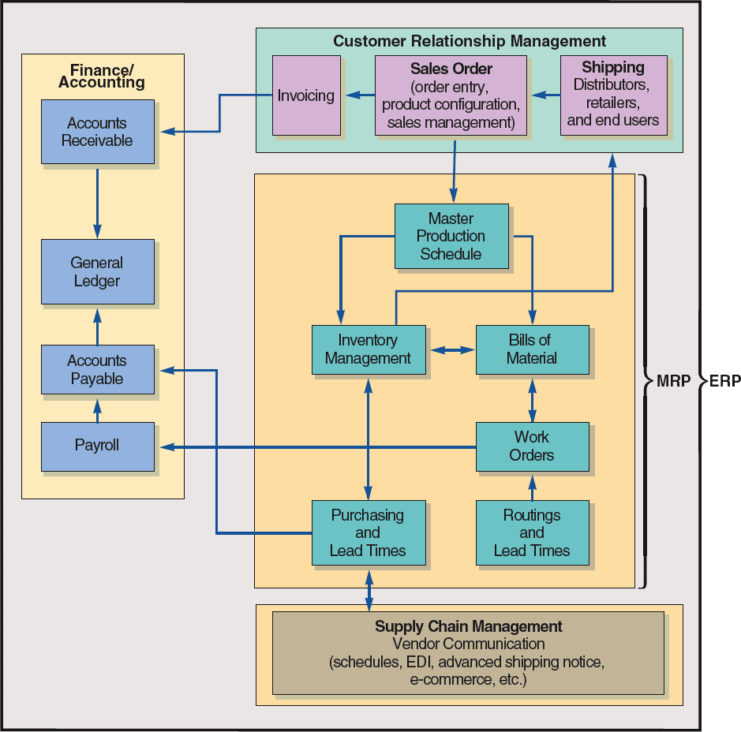
ERP and MRP
Figure 14.11

Slide 80
ERP and MRP
Customer Relationship Management
Sales Order
(order entry,
product configuration,
sales management)
Shipping
Distributors, retailers,
and end users
Invoicing
Figure 14.11

Slide 81
ERP and MRP
Master Production Schedule
Inventory Management
Bills of Material
MRP
Work Orders
Purchasing
and
Lead Times
Routings
and
Lead Times
Table 13.6
Figure 14.11

Slide 82
ERP and MRP
Supply Chain Management
Vendor Communication
(schedules, EDI, advanced shipping notice,
e-commerce, etc.)
Figure 14.11

Slide 83
ERP and MRP
Finance/
Accounting
Accounts Receivable
General Ledger
Accounts Payable
Payroll
Table 13.6
Figure 14.11

Slide 84
Enterprise Resource Planning (ERP)
ERP can be highly customized to meet specific business requirements
Enterprise application integration software (EAI) allows ERP systems to be integrated with
  Warehouse management
  Logistics
  Electronic catalogs
  Quality management

Slide 85
Enterprise Resource Planning (ERP)
ERP systems have the potential to
  Reduce transaction costs
  Increase the speed and accuracy of information
Facilitates a strategic emphasis on JIT systems and integration

Slide 86
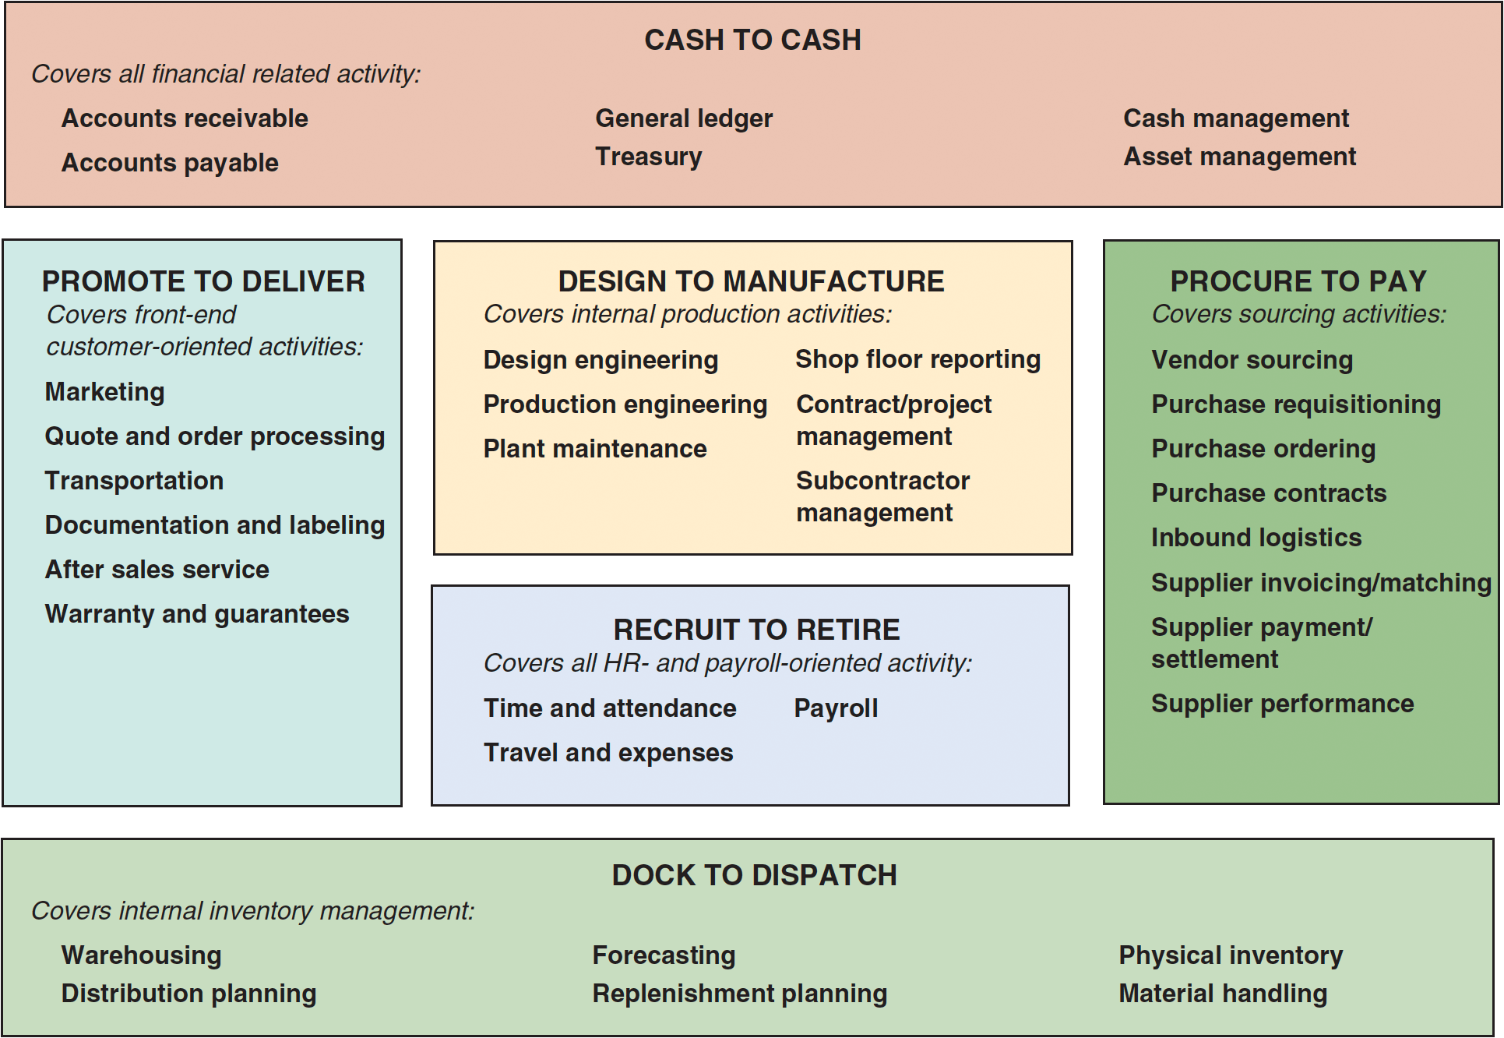
SAP’s ERP Modules
Figure 14.12

Slide 87
Advantages of ERP Systems
Provides integration of the supply chain, production, and administration
Creates commonality of databases
Can incorporate improved best processes
Increases communication and collaboration between business units and sites
Has an off-the-shelf software database
May provide a strategic advantage

Slide 88
Disadvantages of ERP Systems
Is very expensive to purchase and even more so to customize
Implementation may require major changes in the company and its processes
Is so complex that many companies cannot adjust to it
Involves an ongoing, possibly never completed, process for implementation
Expertise is limited with ongoing staffing problems

Slide 89
ERP in the Service Sector
ERP systems have been developed for health care, government, retail stores, hotels, and financial services
Also called efficient consumer response (ECR) systems
Objective is to tie sales to buying, inventory, logistics, and production

Slide 90

All rights reserved. No part of this publication may be reproduced, stored in a retrieval system, or transmitted, in any form or by any means, electronic, mechanical, photocopying, recording, or otherwise, without the prior written permission of the publisher.
Printed in the United States of America.

